Slide 1

APPLICATION OF MACHINE LEARNING FOR SOLAR POND AUTOMATION

Slide 2




Presentation Team
Dr. Jaya Christian
(MENTOR)
Assistant Professor
Department of Mechanical Engineering
Mohammed Sahil Student
VI Sem
Department of Mechanical Engineering
Manish Gautam Student
VI Sem
Department of Mechanical Engineering
Sanskar Sharma Student
VI Sem
Department of Mechanical Engineering

Slide 3
Table of Contents
1. Introduction
2. Motivation Factor
3. Problem definition and Objectives
4. Work plan
4.1. Timeline and Roadmap
5. Tools and Technology
5.1 Python programming Language
5.2 Machine Learning
5.3 Development of User Interface
5.4 Deployment
5.5 Methodology
6. Result and Discussion
7. Conclusion
8. References

Slide 4
Introduction
1
Let’s start

Slide 5
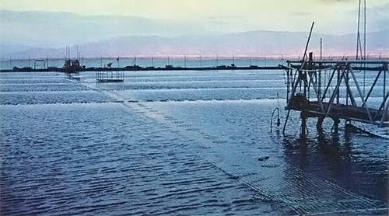
Solar Pond
A solar pond is a pool of saltwater that collects and stores solar thermal energy. The saltwater naturally forms a vertical salinity gradient in which low-salinity water floats on top of high salinity water.

Slide 6
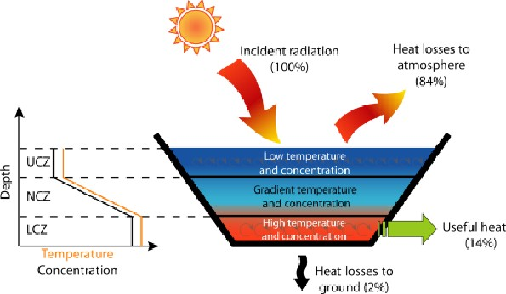
Introduction on Solar Pond
Fig.1.0
The layers of salt solutions increase in concentration with depth. Below a certain depth, the solution has a uniformly high salt concentration.
When the sun's rays contact the bottom of a shallow pool, they heat the water adjacent to the bottom. When water at the bottom of the pool is heated.

Slide 7
It becomes less dense than the cooler water above it, and convection begins. Solar ponds heat water by impeding this convection.
Salt is added to the water until the lower layers of water become completely saturated.
High-salinity water at the bottom of the pond does not mix readily with the low-salinity water above it, so when the bottom layer of water is heated, convection occurs separately in the bottom and top layers, with only mild mixing between the two.
This greatly reduces heat loss and allows for the high-salinity water to get up to 90 °C while maintaining 30 °C low-salinity water. This hot, salty water can then be pumped away for use in electricity generation, through a turbine, or as a source of thermal energy

Slide 8

Motivation Factor :
2
Factor of Motivation

Slide 9

1. Easily identifies trends and patterns
Learning can review large volumes of data and discover specific trends and patterns that would not be apparent to humans. For instance, for an e-commerce website like Amazon, it serves to understand the browsing behaviors and purchase histories of its users to help cater to the right products, deals, and reminders relevant to them. It uses the results to reveal relevant advertisements to them.
2. No human intervention needed (automation)
With ML, you don’t need to babysit your project every step of the way. Since it means giving machines the ability to learn, it lets them make predictions and also improve the algorithms on their own. A common example of this is anti-virus softwares; they learn to filter new threats as they are recognized. ML is also good at recognizing spam.

Slide 10
3.Continuous Improvement
As ML algorithms gain experience, they keep improving in accuracy and efficiency. This lets them make better decisions. Say you need to make a weather forecast model. As the amount of data you have keeps growing, your algorithms learn to make more accurate predictions faster.
4.Handling multi-dimensional and multi-variety data
Machine Learning algorithms are good at handling data that are multi-dimensional and multi-variety, and they can do this in dynamic or uncertain environments.

Slide 11
Problem Definition and Objectives
3
What is the Problem all about?

Slide 12

Solar ponds are continuously using in thermal power plants for steam generation and with the help of steam power(electricity) can be developed. But during the process of steam generation, a lot of water will be wasted, a lot of human effort and time consumption will be more. Various gases like carbon dioxide and nitrogen that is coming out from the power plants responsible for pollution in the atmosphere.
With the help of our application, we will automate the testing of solar ponds( able to predict the outlet temperature of steam) without wasting any resources like water. We will reduce the time consumption as well as pollution in the atmosphere

Slide 13
Objectives :
● We will automate the performance analysis of the solar pond with our application.
● We will reduce human work because harmful gases like carbon dioxide, nitrogen, etc. cause lungs related diseases.
● We will reduce the time consumption for power generation.

Slide 14
● We will increase the accuracy of the solar pond so that it can generate more heat.
● We can save water because our application will automate the performance analysis of solar ponds.
● We can reduce thermal pollution and save the environment.

Slide 15
Work plan :
4
Our Detailed Time line

Slide 16
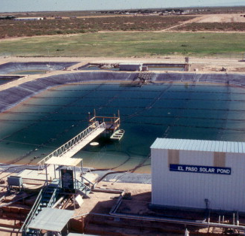
Our project
The whole plan of this project from March to May 2021 is given below in the form of a flow chart. We have divided our work into different time frames so that each work can be done perfectly without any difficulty

Slide 17
Time line and Roadmap :
4.1
Path followed

Slide 18

Timeline
Collection of Data
The beginning – Project Idea Selection
Implementation of Algorithm
Deployment of Application
MAR 20
25 MAR-05 APR
06 APR- 15 APR
16 APR – 28 APR
29 APR – 5 MAY
06 MAY - 18 MAY
19 MAY
20 MAY
Collection of Research papers
Data Analysis
Development of UI
Presenting our efforts-taking it further

Slide 19
Roadmap
Looking for a project
Collection of Data and relevant research
Development of the UI
Deployment of the Application
1
3
5
2
4
6
Implementation of the algorithm –our testing journey begins
Collection of Research papers
Getting prepared for the presentation –
Our results

Slide 20
Tools and Technology :
5
Our Detailed Methodology

Slide 21

Tools and Technology:
Python Programming Language
Linear Regression
(Machine Learning Algorithm)
Jupyter Notebook
Development of UserInterface
Deployment
Methodology

Slide 22

5.1. Python Programming
Python is a high-level, general-purpose, and very popular programming language. Python programming language (latest Python 3) is being used in Machine Learning applications, along with all cutting-edge technology in Software Industry.

Slide 23

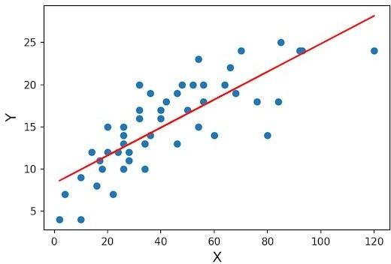
5.2. Machine Learning (Linear Regression )
Linear Regression is a supervised machine learning algorithm where the predicted output is continuous and has a constant slope. It's used to predict values within a continuous range, (e.g. sales, price).
Fig.2.0

Slide 24

5.3. Jupyter Notebook
It is an IDE that allows writing python code for data analysis and also very useful for the implementation of machine learning algorithms

Slide 25
5.4. Development of UserInterface
A model obtained by a machine learning algorithm is not useful without a user interface. HTML and CSS are used for the development of user interfaces.
Need of user interface
➢ Positive user experience
➢Increased user engagement and retention
➢ Increased productivity

Slide 26
Mobile Interface
Solar Pond Performance Predictor
Show and explains thew software project using the interface developed .

Slide 27
Desktop Interface
Solar Pond Performance Predictor
Show and explain the web, app or software projects as developed.

Slide 28

5.5. Deployment
This is the final stage of the project. All the code with user interface pushes into production so that people can use it for business and manufacturing purposes. For the deployment purpose, we have used the Heroku platform.

Slide 29
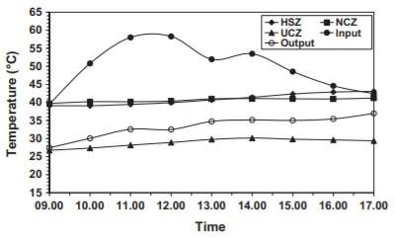
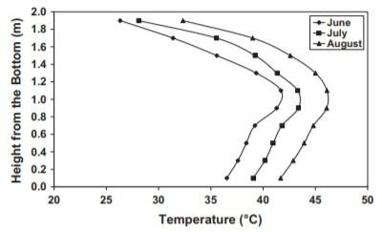
Methodology
Collection of research papers and books for the solar pond performance data and graphs.
Fig.3.0
Fig.3.1

Slide 30
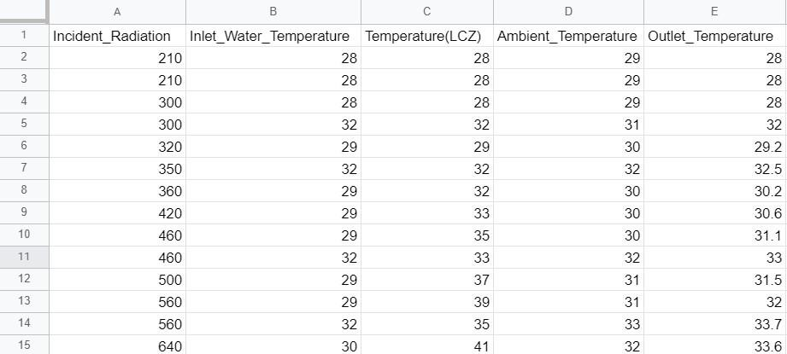
Collection of datasets from papers and converting this data into excel format in MS Word.
Fig.4.0

Slide 31
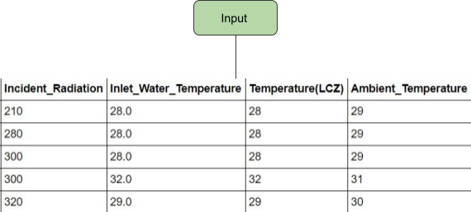
Data will be divided into two components one is input data and another one is the output that is required data. In this case incident radiation, inlet water temperature, temperature(LCZ), ambient temperature are input features and outlet temperature is output.
Fig.4.2

Slide 32
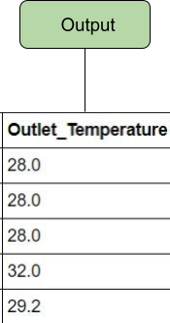
Implementation of machine learning (linear regression) algorithm to the data for the development of a model that will predict the outlet temperature. After that save a model into a pickle file for future usage.
Fig.4.3

Slide 33
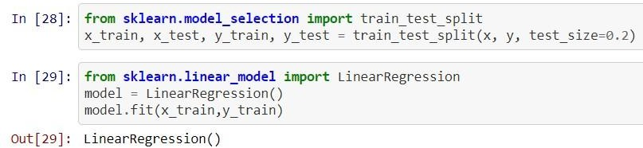
Code Snippet :
● Development of user interfaces with the help of HTML and CSS so that the productivity of the application will increase.
● Deployment of an application on the platform (Heroku)

Slide 34
Result and Discussion :
6
Discussion

Slide 35
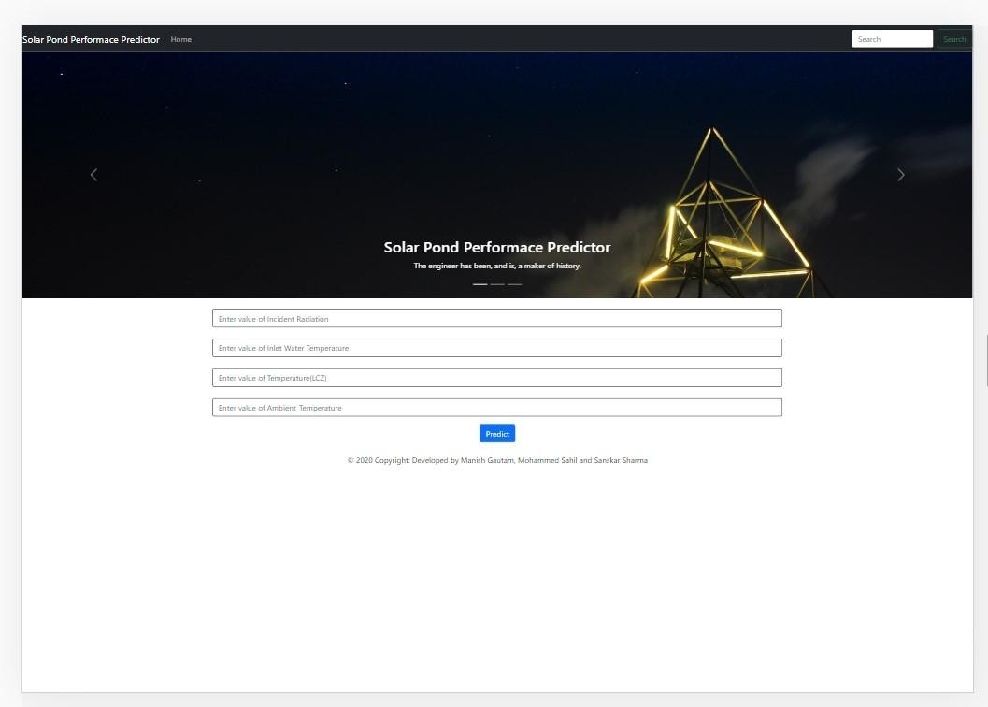
Result
The Interface
Computer/laptop version
Fig.5.0

Slide 36
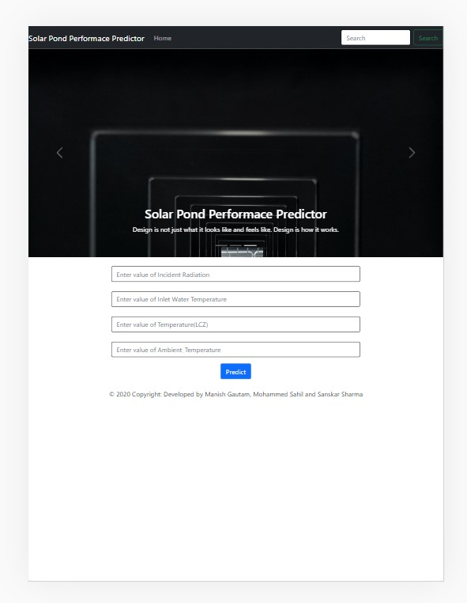
Result
iPad Pro version
Fig.5.1

Slide 37
Link of all the files and the algorithm used
https://drive.google.com/drive/folders/1UpAjjVGPUyovr-yWNDqSCHg5AiyukAHM?usp=sharing
The program execution is shown here using the Interface

Slide 38
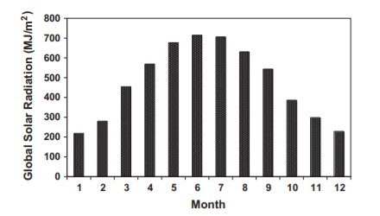
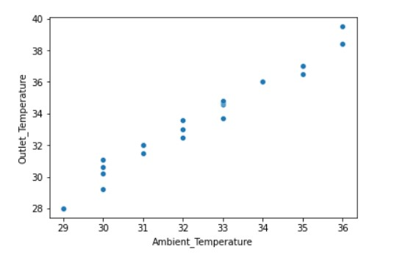
Discussion :
The graphs and Accuracy
Solar Radiation v/s Month
Fig.5.3
Outlet temperature v/s Ambient temperature
Fig.5.2

Slide 39
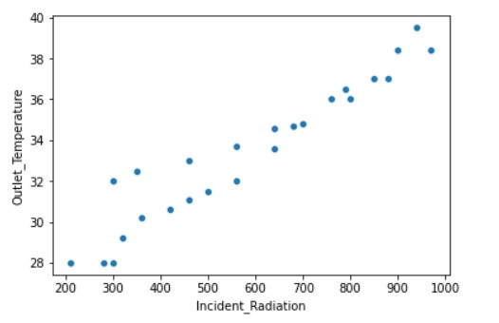
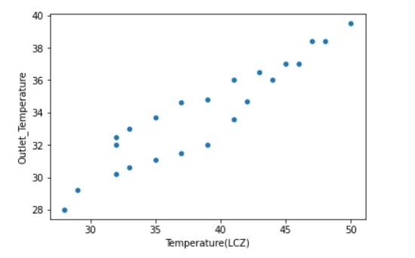
The Graph
Outlet Temperature v/s Incident Radiation
Fig.5.4
Outlet Temperature v/s LCZ
Fig.5.5

Slide 40
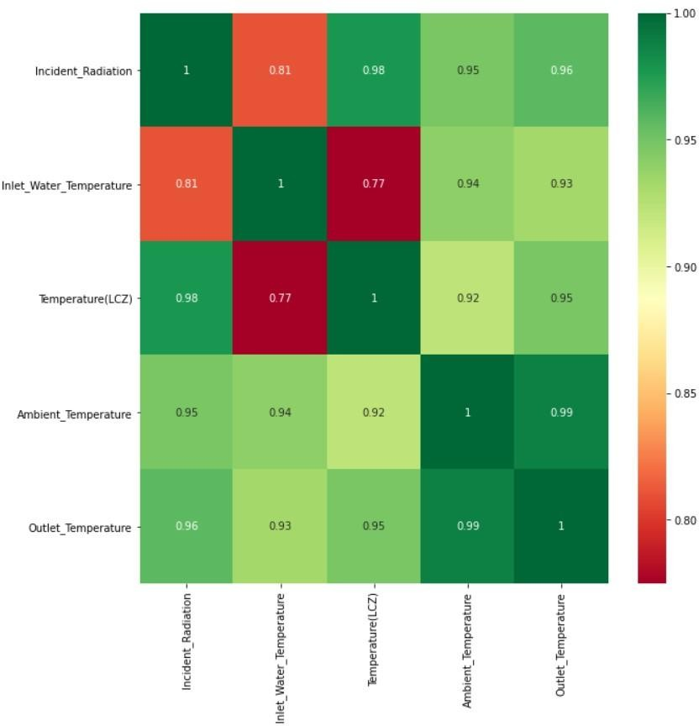
The Graph
Fig.5.6

Slide 41
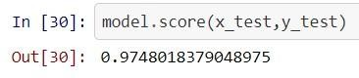
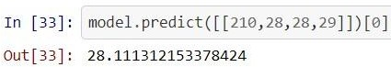
Accuracy
The accuracy of this application depends on the quality of data analysis that we performed at the initial stage of the project. In our condition, we made this model or application with an accuracy of 97% (Because of less data).
Fig.5.7
This is how applications predict the output for given input parameters.
Fig.5.8

Slide 42
Conclusion :
7
The Future

Slide 43
Conclusion:
➢ Performance: This application will help to increase the rate of power generation in thermal power plants because of less processing time and high response time.
➢ Usability and ease of use: The user will be provided a complete user manual as a pdf. The interface is designed to make it easy for any potential user to get familiar with the system within one hour only. No additional training is required.
➢ Capacity: This application can accommodate many users at a time.
➢ Availability: The application will available for 24 hours. Meantime to failure and mean time to repair will be decided to increase the availability.

Slide 44
References :
8
Books and papers

Slide 45
Books :
1. Benjamin Schober, Membrane Stratified Solar Ponds,Högskolan i Gävle,June 2010
2. Kamyar Enshayan, B.S., M.S.,Measurement Of Olar Radiation Transmission In Solar Ponds,Enshayan, K. and T.H. Short. 1986.
3. Ahmad Aizaz,Construction And Analysis Of A Salt Gradient Solar Pond For Hot Water Supply,College of Aeronautical Engineering, National University of Science and Technology,2003
4. Wessam E. Abd Allah,Collecting And Storing Solar Energy: Solar Pond Technology, Lap Lambert Publishing,jan 2013

Slide 46
Research Papers :
[1]Ismail Bozkurt a,1, Mehmet Karakilcik b,The daily performance of a solar pond integrated with solar collectors,Received 13 April 2011; received in revised form 30 December 2011; accepted 22 February 2012
Available online 19 March 2012,Communicated by: Associate Editor Aliakbar Akbarzadeh
[2] Zaenab Muslimin1, Agus Siswanto1,Indar Chaerah Gunadin1, and Muhammad Anshar1,Real Time Monitoring of Salinity Gradient and Solar Pond Temperature,1.Departement of Electrical Engineering Hasanuddin of University
[3] J. A. Du e, and W. A. Beckman ‘’Solar Engineering of Thermal Processes’’ 3rd Ed. ,John Wiley & Sons (2006) 652.
[4] H. M. Lu, A. H. P. Swift, H. D. Hein and J. C. Walton, ‘’Advancements in salinity gradient solar-pond technology based on sixteen years of operational experience’’ J. Sol.EnergyTrans. ASME 126 (2004) 759-767.
[5] J. F. Kreider and F. Kreith ‘’Solar heating and Cooling Active and Passive Design’’ (1982) 284.
p://www.eoearth.org/article/Solar_radiation
[6] C.G. Abbot ‘’The Solar Constant’’ Solar Energy 9(2) (1965) 166-167.

Slide 47
[7]G.N. Tiwari, H.N. Singh and R. Tripathi, Present status of solar distillation,Solar Energy, 75 (2003) 367–373.
[8]A.A. El-Sebaii, S. Aboul-Enein and E. El-Bialy, Single basin solar still with baffle suspended ab- sorber, Energy Conv. Mgmt., 41 (2000) 661–675.
[9]K. Srithar and A. Mani, Comparison between simulated and experimental performance of an open solar flat plate collector for treating tannery effluent, Int. Comm. Heat Mass Transfer, 30 (2003) 505–514.
[10]K. Srithar and A. Mani, Analysis of an open flat plate collector for evaporating tannery effluent, Intern-
ational Conference on New millennium — Alter- native energy solutions for sustainable development, Coimbatore, India, 2003, pp. 65–72.
[11]K. Srithar, A. Mani and A. Venkatesh, Spray eva- poration system for treating tannery effluents, Proc. ANERT National Conference on Renewable Energy, Thiruvananthapuram, India, 1999, pp. 159–164.

Slide 48
[12]K. Srithar, S.Manicka Deepan and A. Sivasankar, Studies on spray evaporation system for tannery effluent (soak liquor) evaporation, in CD, XIII
National Conference of Indian Society of Mechanical Engineers, IIT-Roorkee, 2003.
[13]A. Mani and S. Murthy, Analysis of an open flat plate collector for tannery effluent treatment, Energy Conv. Mgmt., 35 (1994) 1061–1071.
[14].HuÈseyin Kurt Fethi Halici, A. Korhan Binarkc,Solar pond conception - experimental and theoretical studies,Zonguldak Karaelmas University, Technical Education Faculty, KarabuÈk, Turkey Sakarya University, Mechanical Engineering Department, Adapazari, Turkey Marmara University, Technical Education Faculty, 81040 Kuyubasi, Istanbul,Turkey,Received 5 March 1999; accepted 2 September 1999
[15].H. C. BRYANT and IAN COLBECK,A solar pond for London,Queen Mary College, University of London, London, England,(Received 24 May 1976; in revised form 13 September 1976

Slide 49
Presentation Team
Dr. Jaya Christian
(MENTOR)
Assistant Professor
Department of Mechanical Engineering
Mohammed Sahil Student
VI Sem
Department of Mechanical Engineering
Manish Gautam Student
VI Sem
Department of Mechanical Engineering
Sanskar Sharma Student
VI Sem
Department of Mechanical Engineering

Slide 50

Solar Pond Automation
End of the Presentation

